Slide 1
Upscaling Basic Sanitation for the Urban Poor (UBSUP)
Background information needed for the Levelling
for a DTF

Slide 2
Levelling
In this session you learn:
What is a benchmark and how to set it up?
Which levels are determining the future set up of the DTF?
What are the important levels for a DTF?
How to read the cross-sectional drawings?
How to level with the collimation method?
Group work

Slide 3
What is a benchmark?
A benchmark is a fixed reference point which does not change during the entire project time
Usually defined at 100,000m altitude
Should be visible from all points of the construction side
All existing and future level points have to be calculated in reference to this reference point

Slide 4
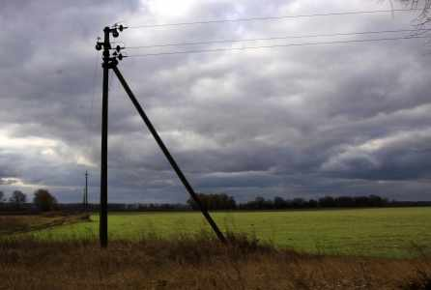
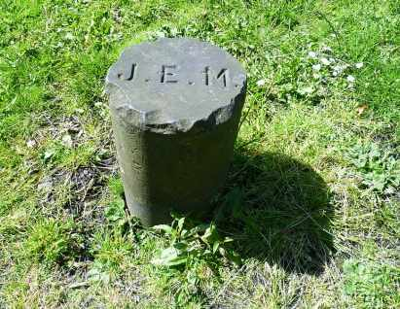
How to set up a benchmark?
Choose a fixed point at an existing and permanent structure (e.g. electricity poste, existing building) or fix your own benchmark at the construction side.
Electricity pole with a nail
Concreted marker stone

Slide 5
What are the important levels for a DTF?
We have to calculate backwards from the effluent discharge point
4
3
2
1
1%
1%
RBBT
1%
ST
1%
ABR
VFCW

Slide 6
How to read the cross-sectional drawings?
Cross sectional drawings are provided in the next training for Design adaptation
Level differences have to be defined individually by the DTF technical team depending on the positioning of the modules

Slide 7
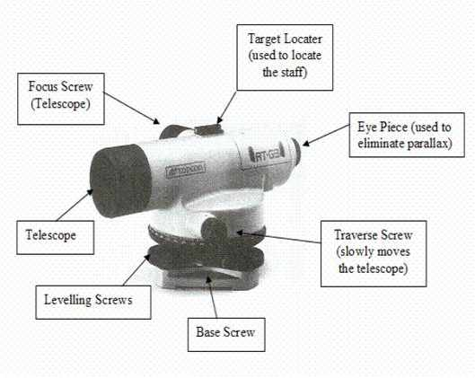
How to use the optical level?
Introduction to the instrument
Level the instrument by adjusting the levelling screws.
The bubble to be central in the circle.
Turn the telescope through 180º
Parallax is the apparent movement of the cross-hairs over the levelling staff when the eye is moved up and down while sighting through the instrument.

Slide 8
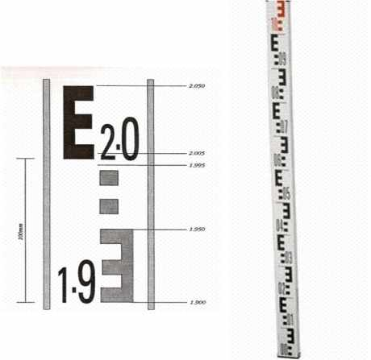
How to use the optical level?
Introduction to the instrument
Sight onto the levelling staff.
Focus the telescope on the staff.
Always ensure the bubble is central
Take the reading of height.
Each square is 1cm (10mm)
First metre is black and second metre is red
Each E is 100mm (0.1m) apart

Slide 9
How to level with the collimation method
The temporary benchmark and height of collimation
Decide for an BM
BM
BM: Benchmark = 100,000

Slide 10
How to level with the collimation method
The temporary benchmark and height of collimation
“Place the rod on top of the BM”
The booking of the levels is done at the same time the reading is taken
HoC
=X
No1= BM
BM: Benchmark = 100,000
HoC: Height of Collimation = OBM + X

Slide 11
How to level with the collimation method
Rules of booking or “the surveyor language”
After moving the optical level the booking procedure remains the same
BS= Back Sight =
the first reading from a new instrument position
BS
IS
FS
BS
IS
IS
FS
IS= Intermediate Sight= occurs between the Back Sight and Foresight
FS= Foresight=
is always the last reading from an instrument position

Slide 12
How to level with the collimation method
Rules of booking or “the surveyor language”
HOC1=101,056 to be added in diagram
HoC1=
100,000+1,056
BS
IS
IS
FS
1,056
No.1:
BM=100,000
BM is the first reduced level!

Slide 13
How to level with the collimation method
Rules of booking or “the surveyor language”
No. | Backsight (BS) | Intermediate Sight (SI) | Fore Sight (FS) | Height of Collimation | Reduced level (RL) | Remarks
1 | 1,056 |  |  | 101,056 | 100,000 | Benchmark
Number it!
First reduced level!
Fill in first reading
= height of optical level
Name the reading

Slide 14
How to level with the collimation method
Rules of booking or “the surveyor language”
HoC1=
100,000+1,056
BS
IS
IS
FS
1,056
2,017
2,398
1,575
No.1= BM=100,000
No.4=
101,056-1,575=
99,481
No.2=
101,056-2,017=
99,039
No.3=
101,056-2,398=
98,658

Slide 15
How to level with the collimation method
Diagram for booking readings
minus
No. | Backsight (BS) | Intermediate Sight (SI) | Fore Sight (FS) | Height of Collimation | Reduced level (RL) | Remarks
1 | 1,056 |  |  | 101,056 | 100,000 | Benchmark
2 |  | 2,017 |  |  | 99,039
3 |  | 2,398 |  |  | 99,658
4 |  |  | 1,575 |  | 99,481 | Change Point
Fill readings into the diagram
Leads to the reduced levels

Slide 16
How to level with the collimation method
Rules of booking or “the surveyor language”
Rod must remain in the old position until the first reading from the new position has been completed!
HoC2=
HoC1-1,575+2,176=101,657
BS
IS
FS
HoC1=
100,000+1,056
BS
IS
IS
FS
2,176
1,839
2,539
1,056
2,017
2,398
1,575
No.1=
BM=100,000
No.4=
101,056-1,575=
99,481
No.2=
101,056-2,017=
99,039
No.5=
101,657-1,839=
99,818
No.6
DP=
101,657-2,539=
99,118
No.3=
101,056-2,398=
98,658

Slide 17
How to level with the collimation method
Diagram for booking readings
No. | Backsight (BS) | Intermediate Sight (SI) | Fore Sight (FS) | Height of Collimation | Reduced level (RL) | Remarks
1 | 1,056 |  |  | 101,056 | 100,000 | Benchmark
2 |  | 2,017 |  |  | 99,039
3 |  | 2,398 |  |  | 99,658
4 | 2,176 |  | 1,575 | 101,657 | 99,481 | Change Point
5 |  | 1,839 |  |  | 99,818
6 |  |  | 2,539 |  | 99,118 | Discharge point
Fill in the new readings
Calculate the Height of collimation for the new position:
HoC2=
101,056-1,575+2,176= 101,657
Reduced level (RL) for Discharge point= 101,657-2,539=99,118

Slide 18
How to level with the collimation method
Diagram for booking readings
No. | Backsight (BS) | Intermediate Sight (SI) | Fore Sight (FS) | Height of Collimation | Reduced level (RL) | Remarks
1 | 1,056 |  |  | 101,056 | 100,000 | Benchmark
2 |  | 2,017 |  |  | 99,039 | ST
3 |  | 2,398 |  |  | 99,658 | ABR
4 | 2,176 |  | 1.575 | 101,657 | 99,481 | Change Point
5 |  | 1,839 |  |  | 99,818 | VFCW
6 |  |  | 2,539 |  | 99,118 | Discharge point
 | 3,232 |  | 4,114
∑
∑
Calculation double check:
∑F.S - ∑B.S = first reduced level – last reduced level
Example:
4,114-3,232=100,000-99,118
0,882 = 0,882

Slide 19
How to level with the collimation method
Calculate the reduced level at the Discharge point (DP)
HoC2=
HoC1-FS+BS=?
BS
IS
FS
HoC1= BM+BS=?
BS
IS
IS
FS
2.67m
2.78m
3.02m
0.52m
2.45m
2.56m
2.27m
BM=1,800.00m
ST outlet=?
Transfer point=?
ABR outlet=?
VFCW outlet=?
DP=?

Slide 20
How to level with the collimation method
Calculate the reduced level at the Discharge point (DP)
No. | Backsight (BS) | Intermediate Sight (SI) | Fore Sight (FS) | Height of Collimation | Reduced level (RL) | Remarks
1 | 0.52m |  |  | 1,800.52m | 1,800.00m | Benchmark
2 |  | 2.45m |  |  | 1,799.48m | ST= 1,800.00-2.45
3 |  | 2.56m |  |  | 1,797.44m | ABR= 1,800.00-2.56
4 | 2.67m |  | 2.27m | 1,800.92m | 1,798.14m | Change Point
5 |  | 2.78m |  |  | 1,798.14m | VFCW
6 |  |  | 3.02m |  | 1,797.90m | Discharge point
 | 3.19m |  | 5.29m
∑
∑
Calculation double check:
∑F.S - ∑B.S = first reduced level – last reduced level
Double Check the calculation!
Example:
5.29m-3.19m=1,800.00m-1,797.90m
2.1m=2.1m

Slide 21
Group Exercise within the DTF technical team :
Time: 20min
Type of exercise: group work of technical DTF team
Transfer the example readings for BS, IS, FS into the booking diagram
Calculate the reduced levels for OBM, Settler outlet, ABR, Temporary Benchmark, VFCW and Discharge Point
Do a calculation double check

Slide 22
How to level with the collimation method
Diagram for booking readings
No. | Backsight (BS) | Intermediate Sight (SI) | Fore Sight (FS) | Height of Collimation | Reduced level (RL) | Remarks
1 | 1.83 |  |  | 1,801.83 | 1,800.00 | BM
2 |  | 0.89 |  |  | 1,800.94 | RB outlet
3 |  | 2.49 |  |  | 1,799.34 | ST outlet
4 | 2.06 |  | 3.27 | 1,800.62 | 1,798.57 | ABR outlet / Ch- point
5 |  |  | 3.66 |  | 1,796.96 | DP
 | ∑BS: |  | ∑FS:

Slide 23
Do you have any questions, remarks or suggestions?

